Slide 1
HOW TO PREPARE WIN8.X AND WIN10 FOR DUAL BOOT
Do you want to install Ubuntu or Linux Mint next to Windows 8.x or 10, in order to create a dual boot computer? Then first you have to change some settings in Windows 8.x or 10, and when you have a pre-installed Windows 8.x or 10, also in the UEFI ("BIOS")

Slide 2
HOW TO PREPARE WIN8.X AND WIN10 FOR DUAL BOOT
DISABLE FAST BOOT

Slide 3
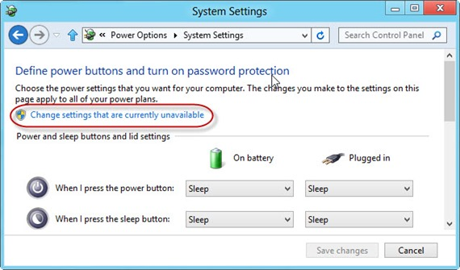
HOW TO PREPARE WIN8.X AND WIN10 FOR DUAL BOOT

Slide 4
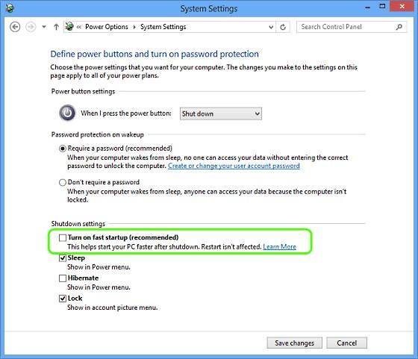
HOW TO PREPARE WIN8.X AND WIN10 FOR DUAL BOOT

Slide 5
HOW TO PREPARE WIN8.X AND WIN10 FOR DUAL BOOT
Save Changes and Reboot
If you are using an older computer that had Win7 installed you would be done and ready to proceed with the installation of Ubuntu.

Slide 6
HOE TO PREPARE WIN8.X AND WIN10 FOR DUAL BOOT
Open the config file of UEFI (in settings or setup)
Disable secure boot
Move Windows boot manager to the bottom of the list
Enable the key for one time priority changes
Save and exit

Slide 7
HOW TO PREPARE WIN8.X AND WIN10 FOR DUAL BOOT
Select a 64 bit for installing Ubuntu or Mint

